Slide 1
Sales Dashboard Overview
By priti Sawant

Slide 2
Objective
To analyze sales performance across categories, time periods, and regions
To identify top-performing products, customers, and months
To support data-driven decision-making
To understand customer trends and profitability

Slide 3
Data Overview
Years Covered: 2014 to 2017
Product Categories: Furniture, Office Supplies, Technology
Sales Channels: Across U.S. states
Key Metrics: Sales amount, profit, customer count

Slide 4
Dashboard Features
Interactive Filters:
By Year and Category
Visuals Included:
Profit over time
Sales by U.S. states
Sales by product category
Monthly sales trends
Top customers by profit
Customer count by year
Color-coded performance maps and graphs
Built using Microsoft Excel

Slide 5
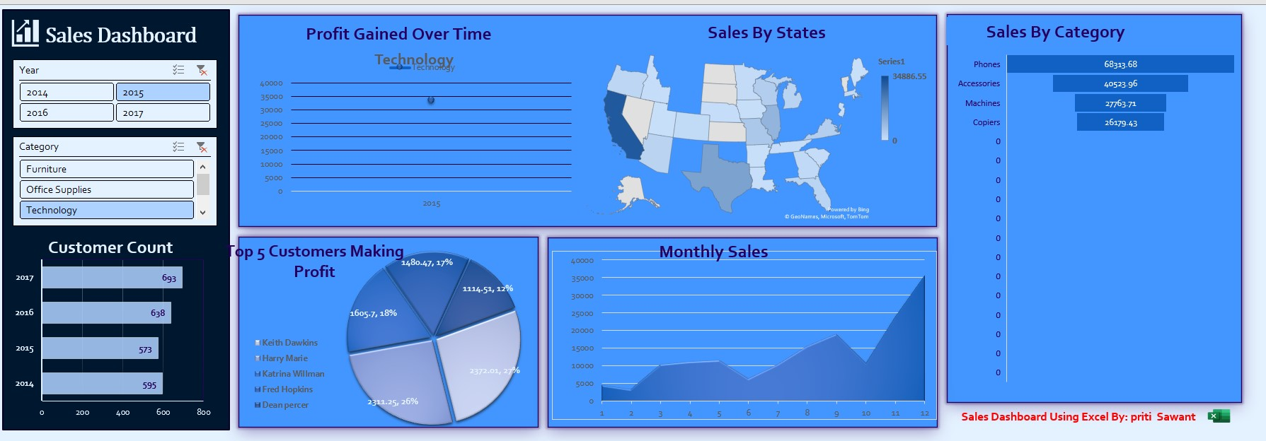
Dashboard Preview

Slide 6
Key Insights
Technology category led in profit gain in 2015
Customer base grew consistently from 2014 to 2017
Monthly sales peak occurred in December
Top 5 customers contributed significantly to overall profit
Sales concentration in select states, indicating regional strengths

Slide 7
Sales Dashboard Summary
Top-Selling Category: Phones ($68,313.68)
Highest Customer Count: Year 2017 (693 customers)
Most Profitable Customer: Dean Percer ($2,372.01 profit)
Best Performing State: California (up to $34,886.55 sales)

Slide 8
Conclusion
Sales and customer engagement have shown positive growth
Certain categories and customers drive most of the revenue
Geographic sales performance reveals market penetration gaps

Slide 9
Next Steps
Focus marketing efforts on high-performing states and categories
Expand in underperforming states with potential
Develop loyalty programs for top customers
Continue tracking monthly trends for promotional planning

